Slide 1

Intro to Rmarkdown

Slide 2
Agenda
What is Rmarkdown
How it works
YAML header
Chunks
Formats – HTML, Word, PDF, Images

Slide 3
What is Rmarkdown
Allows us to create documents that serve as a neat record of your analysis. In the world of reproducible research, we want other researchers to easily understand what we did in our analysis.

Slide 4
What is Rmarkdown
R Markdown allows us to create reproducible documents that weave narrative text together with R code and the output it produces when executed.
```{r cars}
summary(cars)
```
speed dist Min. : 4.0 Min. : 2.00 1st Qu.:12.0 1st Qu.: 26.00 Median :15.0 Median : 36.00 Mean :15.4 Mean : 42.98 3rd Qu.:19.0 3rd Qu.: 56.00 Max. :25.0 Max. :120.00 | speed dist Min. : 4.0 Min. : 2.00 1st Qu.:12.0 1st Qu.: 26.00 Median :15.0 Median : 36.00 Mean :15.4 Mean : 42.98 3rd Qu.:19.0 3rd Qu.: 56.00 Max. :25.0 Max. :120.00

Slide 5
How it works
R Markdown is the unification of 3 frameworks:
Markdown, to format text
knitr, to process R code chunks
YAML/pandoc, to allow a variety of output formats
When we render the document, the following happens:

Slide 6
Starting your first markdown file
1. Choose File -> New File -> R Markdown... 2. Fill the Title field and Author fields 3. In the left menu, select Document, and for Default Output Format select option HTML (these are the defaults). 4. Click OK

Slide 7
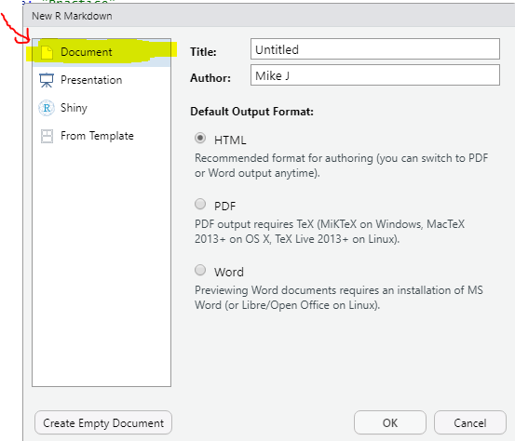
Starting your first markdown file
1. Fill the Title field and Author fields 2. In the left menu, select Document, and for Default Output Format select option HTML (these are the defaults). 3. Click OK

Slide 8
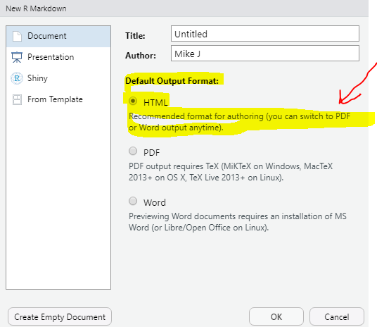
Starting your first markdown file
Default Output Format select option HTML Click OK

Slide 9
YAML header
“Yet Another Markup Language”
used to control:
which output format to use (HTML, LaTeX pdf, etc.)
overall appearance of the document
adding other files to add content or style the document

Slide 10
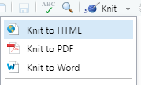
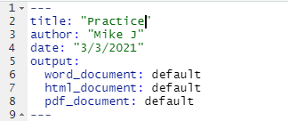
YAML header

Slide 11


Slide 12
Markdown (body of the document)
Markdown is a markup language, a system of code shortcuts to annotate and format plain text – once the .rmd file is compiled
Markdown is a markup language, a system of code shortcuts to annotate and format plain text – once the .rmd file is compiled
## R Markdown and ## Including plots: The ## signifies that the text following is to be treated as a section header (or a new slide for a slide show)
**Knit**: The ** signify that “Knit” is to appear in bold
## and ** are Markdown tags which format the text enclosed within them.

Slide 13
R code chunks
highlighted with gray backgrounds and enclosed within ```{r } and ```.
The R code chunks are actually processed by the package knitr, which is installed with rmarkdown.
When the R Markdown file is compiled and rendered, the output of the code chunk will be embedded in the document underneath the code.

Slide 14

R code chunks are delimited by ```{r chunk_label, options} at the beginning and ``` at the end. The chunk_label and options are indeed optional and are separated by commas
use the shortcut Ctrl + Alt + I

Slide 15
Chunk header
To specify chunk options, after ```{r, specify a chunk label (name), and comma, and then a list of options separated by commas. This is known as the chunk header.
All of the chunk options must be specified on one line (no line breaks).
Use only alphabetic characters and -.

Slide 16

Chunk header
Chunk Header

Slide 17
```{r, mydata, echo=FALSE}
mydata is the chunk label, and echo=FALSE is an option
echo=FALSE suppresses printing of the R code. By default, echo is set to TRUE

Slide 18
Options for code chunks
echo:(TRUE) whether to print the R code to the document. Can be set to a vector of numbers to print only specific lines of code.
eval:(TRUE) whether or not to evaluate (run) the R code chunk. Can be set to vector of numbers to evaluate only specific lines of the code, e.g. eval=1:3 evaluates only the first 3 lines of code.
include:(TRUE) whether to include the R code and output in the document. Differs from eval in that if include=FALSE, the R code is still evaluated, but nothing is printed to the document.
results:('markup') how to print results (note use of single quotes for setting values)

Slide 19
GLOBAL CHUNKS
If you know that you will need to set an option for multiple or all chunks, you can set them globally with a call to knitr::opts_chunk$set() in the first code chunk of the .rmd file.
A. Insert a new code chunk before the “# Purpose” header.
B. Give the chunk the label “setup” in the header.
C. Specify this code inside the chunk: knitr::opts_chunk$set(echo=FALSE).

Slide 20
Warning messages
message:(TRUE) whether to print messages to the document
warning: (TRUE) whether to print warnings to the document

Slide 22
Inline R code
We can also insert R code directly into text, which will be replaced by its output when rendered.
Enclose the inline R code with `r and `.
Inline R code itself will not be printed to the document.
Use Markdown tags to format the ouptut. `r mean(sleep$extra)`

Slide 23
Compiling and rendering
two ways:
Click the Knit button (Ctrl+Shift+K) in RStudio
Call rmarkdown::render(“filename.rmd”) in the R Console
*The Knit button calls the render()

Slide 24
External images
Embedding external images (not created by R code within the document) in a document uses syntax very similar to linking:
![Caption](image_location)
setwd("F://DIRECTORY//")
(within the white space)
![hi.jpg](F://DIRECTORY //hi.jpg)

Slide 25


Slide 26

Tex Math
$mean(X) = \frac{\sum\_{i=1}^nX}{n}$
will be rendered as

Slide 27
Output Formats
WORD
PDF
HTML

Slide 29

Intro to Strings in R
nchar()
toupper()
tolower()
paste()
strsplit()
sprintf()
substr()
cat()
grep()

Slide 30
Nchar()
counts the number of characters including spaces in a string.
result <- nchar("Statistical Seminars is Fun")
print(result)
27

Slide 31
Toupper() & tolower
Changes the text to either lower of upper case
result <- "Statistical Seminars is Fun"
toupper(result )
tolower(result )
result <- toupper("Changing To Upper")
print(result)

Slide 32
Sprintf()
string formatting like in the C language
sprintf("%s scored %.2f percent", "Matthew", 72.3)
sprintf("%2$f scored %1$s percent", "Matthew", 72.3)

Slide 33
Sprintf()
Notation | Description
%s | a string
%d | an integer
%0xd | an integer padded with x leading zeros
%f | decimal notation with six decimals
%.xf | floating point number with x digits after decimal point
%e | compact scientific notation, e in the exponent
%E | compact scientific notation, E in the exponent
%g | compact decimal or scientific notation (with e)

Slide 34
Substr()
extract or replace substrings in a character vector
x1 <- "Get excited"
substr(x1, start = 5, stop = 13)

Slide 35
Paste()
Combine strings in R
a <- "Hello"
b <- 'How'
c <- "are you? "
print(paste(a,b,c))

Slide 36
Strsplit()
split the strings into substrings with split arguments
str = "Splitting sentence into words"
strsplit(str, " ")

Slide 37
Cat()
Combines strings together
str1 <- “Cool"
cat (“Stats Seminars is : ", str1)
Stats Seminars is : Cool

Slide 38
Grep()
returns a vector of indices of the character strings that contains the pattern
x <- c("d", "a", "c", "abba")
grep("a", x)

Slide 39
SUB()
replace the text in an R string
base <- "Wow that was cool."
sub("cool", "AWESOMAZING!", base)

Slide 41
Stringr package
str_length()
str_c()
str_to_upper()
str_split()

